Slide 1




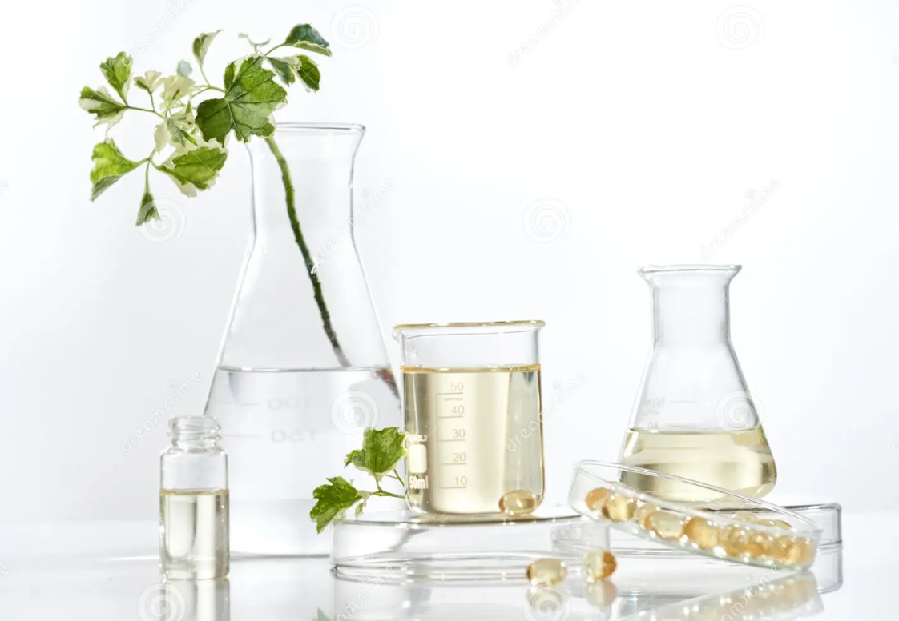


The 11th international seminar on chemistry and Environment
Title
A^{1*}, B², C³
^{1,2,3}Chemistry Department, Faculty of Science, Azarbaijan Shahid Madani University, Tabriz, Iran
Email*:
Azarbaijan Shahid Madani University
Introduction
Add Text here........
Experimental
Add Text here........
Conclusion
Result and Discussion
Add Text here........
Add Text and photos here........
References
Add Text here........
References should be written according to below sample
[1] M. Babaei, H. Eshghi, Kh. Abnous, M. Rahimizadeh, M. Ramezani, Cancer Gene Therapy, 2017, 24, 156.
[2] J.W. Steed, J.L. Atwood, Supramolecular Chemistry. 2nd Edition ed., John Wiley & Sons, Ltd: 2009.

